Slide 1
Lecture # 03
The Image of the City
Kevin A. Lynch

Slide 2
The image of the city
What does the city’s form actually mean to peole who live there? / What can the city planner do to make the city’s image more vivid and memorable to the city dweller?
To answer these questions, Lynch has studied the experience of the people who live in Los angles, Boston and New Jersey. With a fund of new material from field studies of these three cities and personal interviews with their inhabitants together with insights from literature, anthropology, psychology and art.
Lynch formulates a new criterion known as imageability and shows its potential value for the building and rebuilding of cities.

Slide 3
What is Imageability?
Imageability is another term introduced by Lynch. It is the quality of a physical object, which gives an observer a strong, vivid image.
He concluded that a highly imageable city would be well formed, would contain very distinct parts and would be instantly recognizable to the common inhabitant.
He also explains that a well-formed city is highly reliant upon the most predominant city element, paths.
Similarly, edges, districts, nodes, and landmarks are favorable contributors to imageability if they are meaningful, distinct, and not confusing. These elements, when placed in good form, increase human ability to see and remember the patterns.

Slide 4
The image of the city
Urban thinker Kevin Lynch was able to establish a notation of city elements that matched people’s perception.
They are identified as:
Districts
Paths
Edges
Nodes
Landmarks

Slide 5
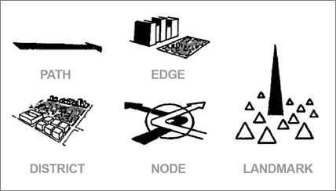

Slide 6
What is a mental map?
A person's perception of the world is known as a mental map. A mental map is an individual's own map of their known world. Mental maps of individuals can be investigated:
by asking for directions to a landmark or other location,
by asking someone to draw a sketch map of an area or describe that area,
by asking a person to name as many places as possible in a short period of time.

Slide 7
Building the image
Environmental images are the result of a two way process between the observer and his/her environment. The environment suggests distinction, relations and the observer select organize and endow with meaning what he sees.
The image so developed limits and emphasizes what is seen while the image itself is being tested against the filtered perceptual input in a constant interacting process.
Different environments resist or faciliate the process of image-making.

Slide 8
Structure and Identity
An environmental image can be analyzed into 3 components: identity, structure and meaning.
A workable image requires first identification of an object which implies its distinction from other things, its recognition as a separable entity. This is called identity, not in the sense of equality with something else but with the meaning of individuality or oneness.
Second, the image must include the spatial or pattern relation of the object to the observer and to other object.
Finally, this object must have some meaning for the observer whether practical or emotional. Meaning is also a relation but quite a different one from spatial or pattern relation.

Slide 9
Structure and Identity
An environmental image can be analyzed into 3If an image has value for orientation in the living space, it must have several qualities;
It must be sufficient
It must be sufficiently clear and well integrated to be economical of mental effort
It should be safe
This is the criteria for a ‘good’ image.

Slide 10
City Image & Its elements
Legibility is a term used to describe the ease with which people can understand the layout of a place.
By making questionnaire surveys, Lynch defined a method of analyzing legibility using the aforementioned elements: paths, edges, districts, nodes and landmarks.

Slide 11
Paths
They are the “channels along which the observer customarily, occasionally, or potentially moves. They may be streets, walkways, transit lines, canals, railroads.“
These are the major and minor routes of circulation that people use to move out. A city has a network of major routes and a neighborhood network of minor routes.

Slide 12
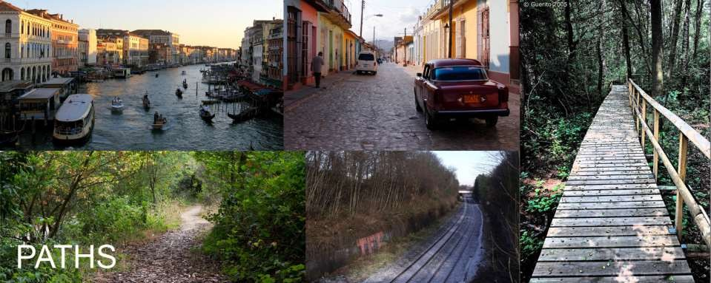

Slide 13
Edges
They are the dividing lines between districts – the linear elements not used or considered as paths by the observer. They are boundaries between two phases, linear breaks in continuity:
Bodies of water (such as an ocean, river, or lake)
Landforms (such as mountains and hills)
Manmade structures (such as buildings, railroad tracks, walls, or highways)
The termination of a district is its edge. Some districts have no edges at all but gradually taper off and blend into another district. When two districts are joined at one edge they form a seam.
Functionality and usage of the spaces are clearly defined by edges.

Slide 14
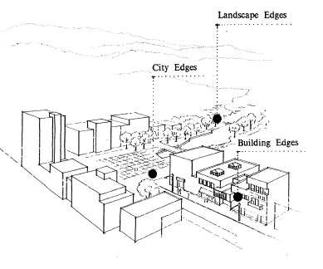

Slide 15
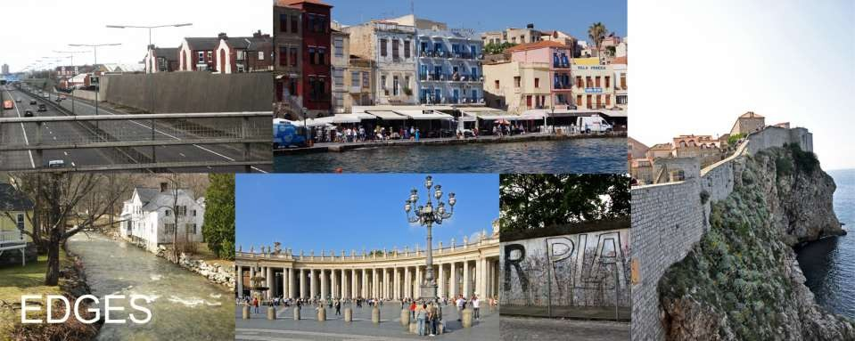

Slide 16
Districts
Areas with perceived internal homogeneity "are medium-to-large sections of the city, conceived of as having two-dimensional extent, which the observer mentally enters ‘inside of,’ and which are recognizable as having some common identifying character“
Areas characterized by common characteristics, these are the medium to large areas, which have some common identifying character.
A city is composed of component neighborhoods or districts; (its center, midtown, its in-town residential areas, organized industrial areas, trainyards, suburbs, college campuses etc.) Sometime they are districts in form and extent.

Slide 17
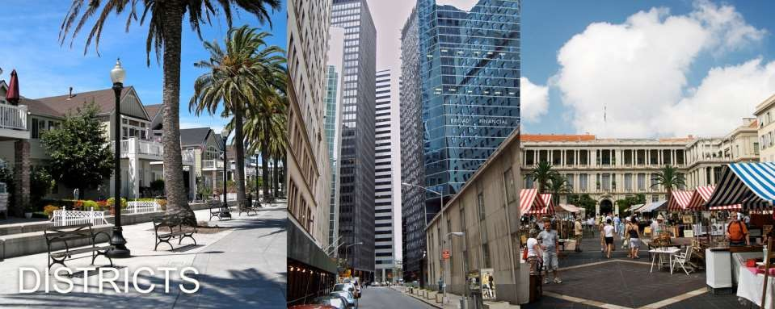

Slide 18
Nodes
They are the centers of attraction that you can enter. They are points, the strategic spots in a city into which an observer can enter, and which are intensive foci to and from which he is traveling, a common point where two or more roads meet to form a junction or square.
A node is a center of activity. Actually it is a type of landmark but is distinguished from a landmark by virtue of its active function. Where a landmark is a distinct visual object, a node is a distinct hub of activity.

Slide 19
Nodes
They may be primary junctions, places of a break in transportation, a crossing or convergence of paths, moments of shift from one structure to another. Or the nodes may be simply concentrations, which gain their importance from being the condensation of some use or physical character, as a street-corner hangout or an enclosed square .

Slide 20
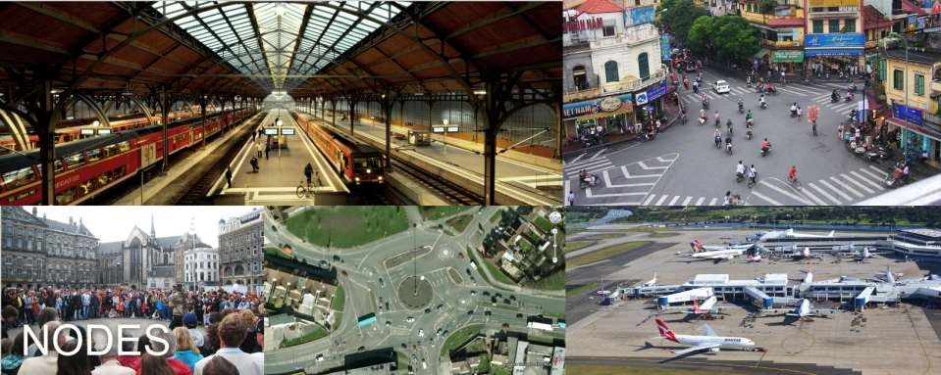

Slide 21
Landmarks
They are another type of point-reference, but in this case the observer does not enter within them, they are external. They are usually a rather simply defined physical object: building, sign, store, or mountain".
The prominent visual features of the city are its landmarks. Some landmarks are very large and seen at great distances, while some are very small (e.g. a tree within an urban square) and can only be seen close up. Landmarks are an important element of urban form because they help people to orient themselves in the city and help identify an area.
Having identified these elements Lynch describes the skeletal elements of city form.

Slide 22
